Slide 1

The Hurricane Bonus Prize
The prize that “bugs” recovery efforts and what you can do about it
Jessica Ber, Environmental Specialist III
Marah Clark, Environmental Administrator

Slide 2
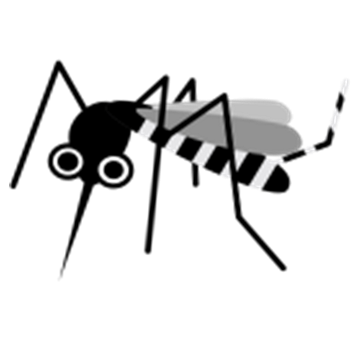
The Bonus Prize:
Mosquitoes!

Slide 3

Discussion Topics
The Hurricane Bonus: biting mosquitoes
What is MCIRT
2024 Storm Season Overview
MCIRT Process
MCIRT Forms
Take Away Points

Slide 4

About Marah
Over 25 years mosquito control experience, focused on mosquito and mosquito borne disease surveillance, resistance, and mosquito education
Environmental Administrator, Entomology and Pest Control Section, BSETA, AES, FDACS
  Oversees several entomology-based programs for the department including support to Florida’s various mosquito control programs
  Serves as a subject matter expert and division vector entomologist for the FDACS Mosquito Control Incidence Response Team

Slide 5
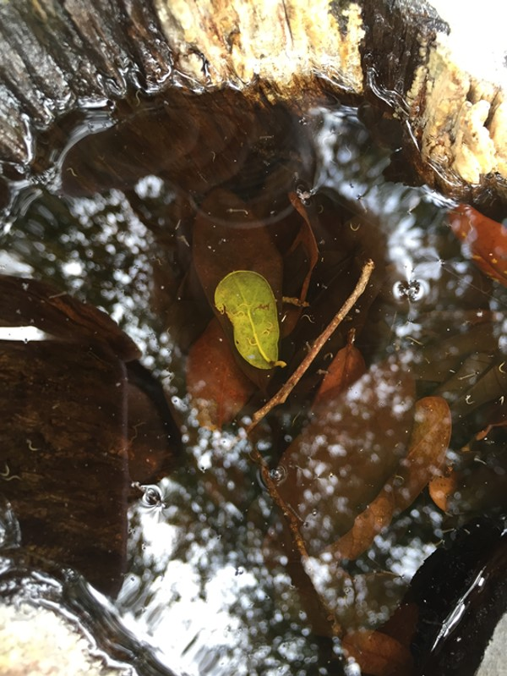
Mosquito Biology Overview
Activation timeline based on mosquito emergences
Approximately 7-10 days post storm
Two emergences: floodwater and standing water mosquitoes
If applications are timed incorrectly, overall efficacy will be affected resulting in second applications at the cost of the state
Notes:
Mosquito populations are likely to increase exponentially following a major hurricane. This is primarily due to higher-than-normal flood waters and increased sources of standing water found in debris. Mosquito populations may elevate past normal ranges as early as 5 to 7 days following the natural disaster. This results in the MCIRT being one of the later response teams deployed. This is to ensure that the assistance provided is efficacious in targeting adult, flying mosquito populations after a storm.

Slide 6
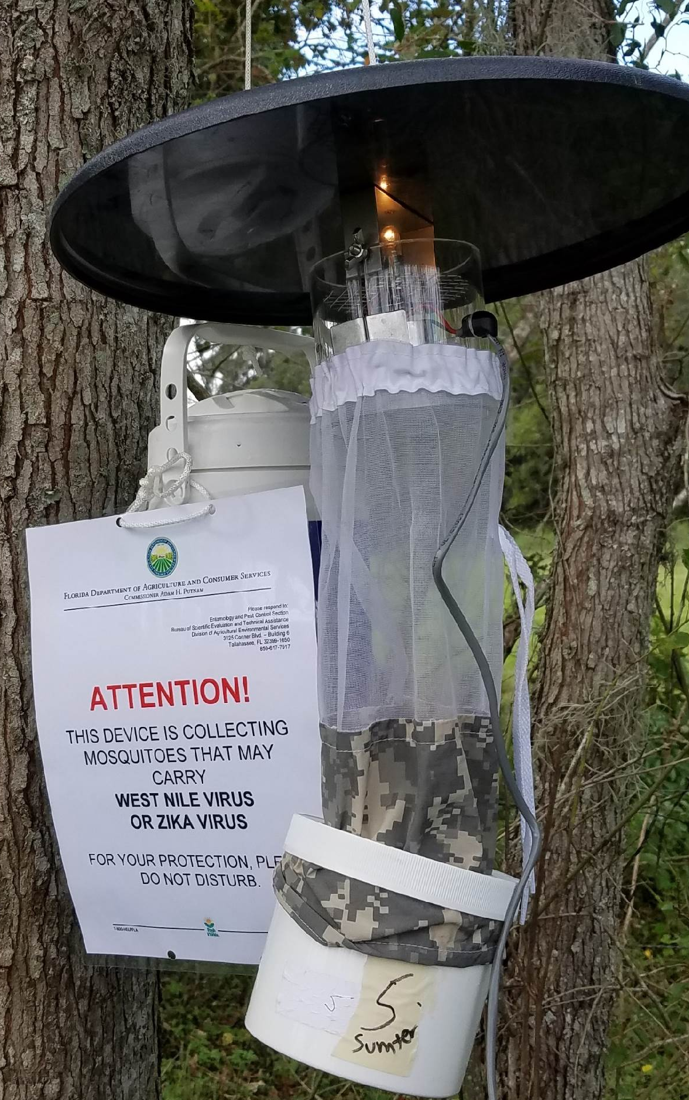
How we assist our Florida counties
GIS mapping of treatment zones
Pre-treatment mosquito surveillance
Trap evaluation (count and identification)
Public notifications (representatives for beekeepers, aquaculture)
Concurrency with USFWS, FDEP, FFWCC
Agreement with CDC
Coordinate with our contractors
Post-treatment surveillance
Notes:
Describe trap mechanism in picture.

Slide 7
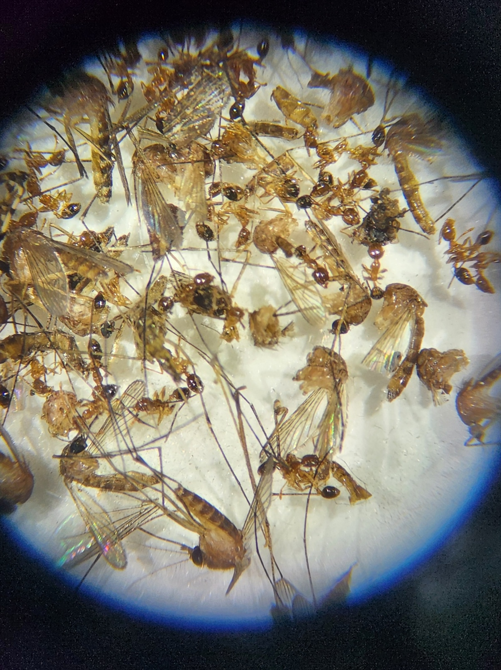
What is MCIRT?
Mosquito Control Incident Response Team
Specialized response team based out of the Division of Agricultural Environmental Services (AES) focusing on coordinating large scale vector control efforts to reduce risk of both disease and nuisance biting mosquitoes that can impact response and recovery efforts
Assembled to respond to counties requesting assistance for vector control typically after a hurricane event, especially in fiscally constrained counties
The team has also been activated for large scale mosquito borne disease events such as West Nile virus and Zika Virus
Notes:
The overall mission for the MCIRT is to assist Florida counties undergoing repair and recovery activities following a disaster with mosquito control abatement.
It is the MCIRT’s job to provide quick assistance through coordinating aerial applications to reduce emerging adult mosquitoes that may impede post-storm recovery efforts. Additionally, the team has been activated in response to large scale mosquito-borne disease events such as West Nile and Zika viruses.
The MCIRT prioritizes assisting counties who are fiscally constrained and/or are incapable of responding to the increased mosquito populations such as caused by excessive damage from the storm.

Slide 8
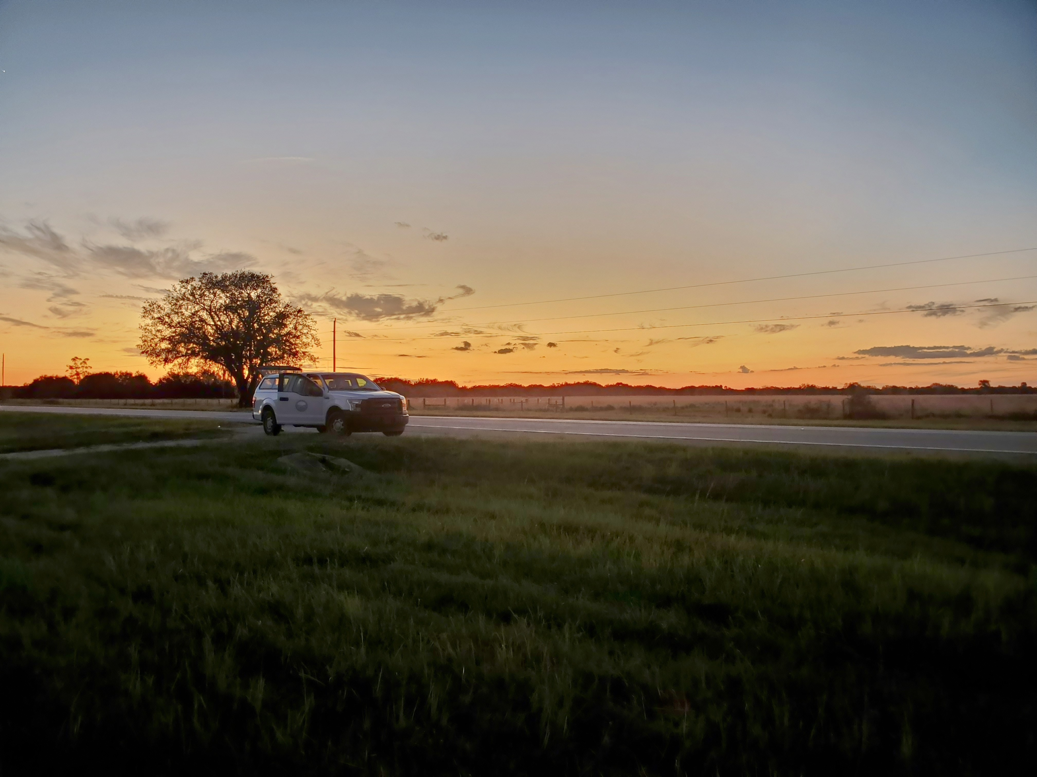
2024 Hurricane Season Synopsis
Landfall: Steinhatchee, Taylor County, Category 1
28 counties impacted
9 counties requested assistance
1,068,403 Acres treated
Landfall: Keaton Beach, Taylor County, Category 4
29 counties impacted
3 counties requested assistance
243,201 Acres treated
Landfall: Siesta Key, Charlotte County, Category 3
37 counties impacted
21 counties requested assistance
3,487,568 Acres treated
Hurricane Debby
Hurricane Helene
Hurricane Milton
August 5
MCIRT:
Activated: 8/15/2024
Deactivated: 8/26/2024
24 FDACS employees participated
September 26
MCIRT:
Activated: 10/15/2024
Deactivated: 10/19/2024
16 FDACS employees participated
October 9
MCIRT:
Activated: 10/21/2024
Deactivated: 11/16/2024
33 FDACS employees participated
Processes Added:
County required to submit checklist
Processes Added:
Risk Assessment /Scorecard /Vulnerability Analysis Map
Baseline Excel Template
Processes Added:
Large Outdoor Events
PIO Info Sheet for counties
County checklist of required documentation
Organic farm exclusion
Notes:
2024 was a busy year for hurricane response with 3 activations: Debby in August, Helene in September, and Milton in October. The MCIRT provided mosquito abatement assistance following all 3 of these hurricanes.
Hurricane Debby impacted 28 Florida counties, most within the Big Bend area. The MCIRT coordinated treatment for just over a million acres across 8 counties. Several new processes were added for 2024’s first activation including solidifying the process of excluding large outdoor events and organic farms, which we will discuss further later.
Hurricane Helene impacted 29 counties in Florida, making landfall in the same county as Hurricane Debby and following a similar path across the Big Bend area. Nearly a quarter million acres were treated within one county. Though three counties requested assistance, one cancelled treatment while the other was assisted after Hurricane Milton instead.
Hurricane Milton was considered the most widespread of the three in Florida, affecting 37 counties. The counties cover most of the peninsula and part of the eastern panhandle. Over 3.5 million acres were treated across 20 different counties.

Slide 9
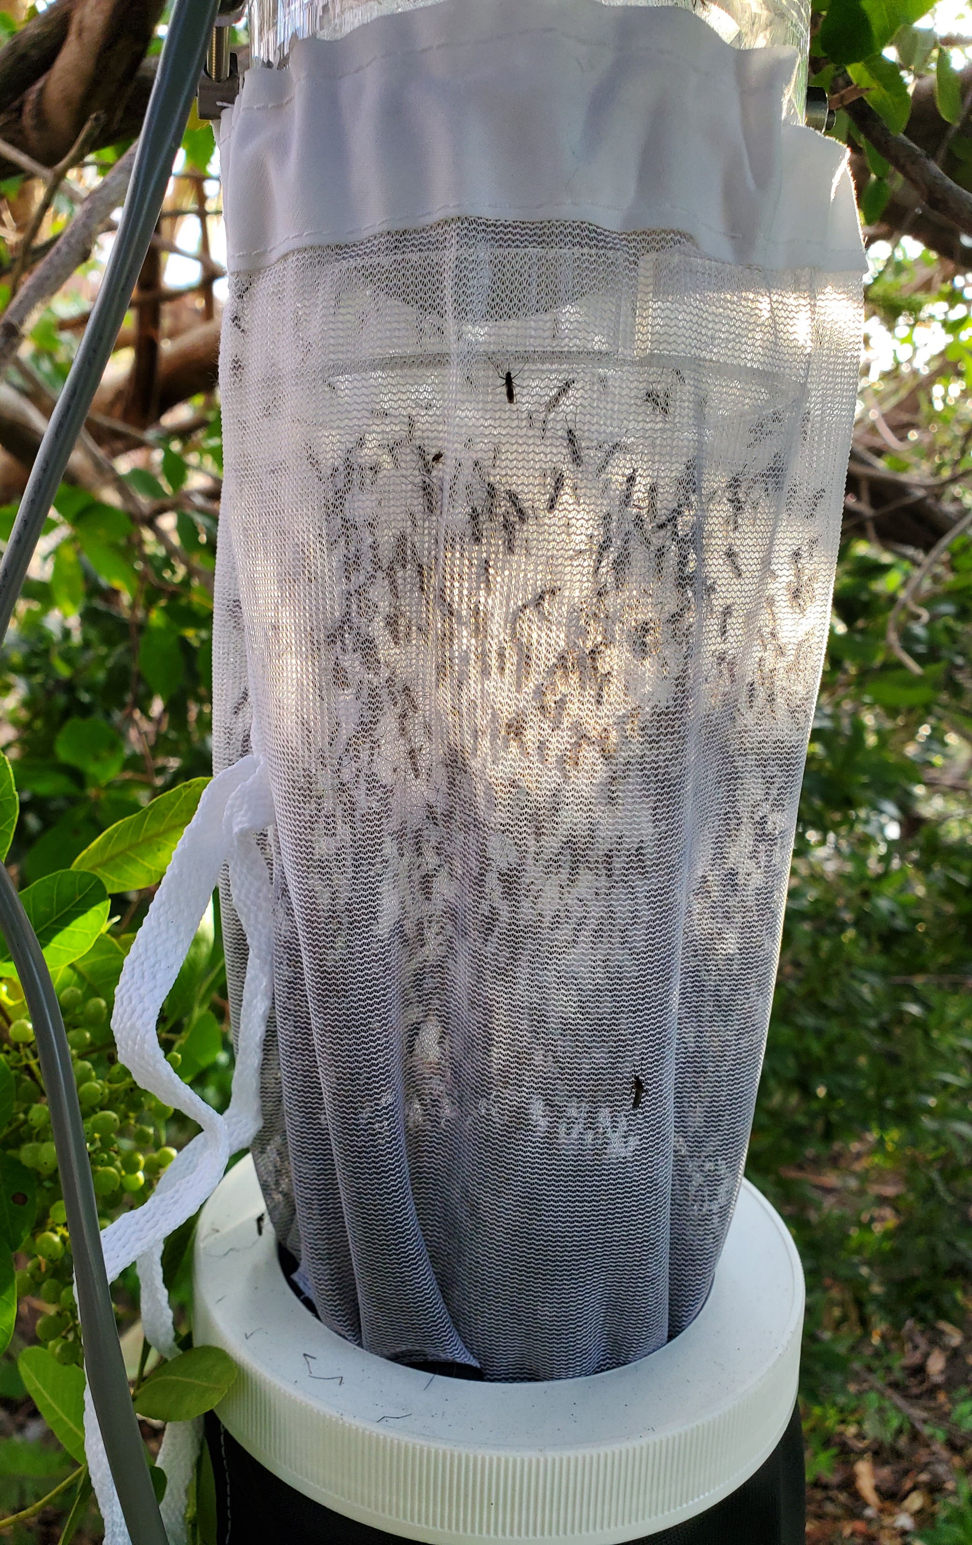
When can I make a request?
Mosquitoes require water for eggs to hatch
Floodwater mosquitoes:
  typically a nuisance, but they can emerge in high numbers
  eggs are laid where water will be
  emerge about 7-10 days after an extreme flooding event
Permanent water mosquitoes:
  concern are disease vector mosquitoes: Culex quinquefasciatus, Culex nigripalpus
  lay eggs on water surface, including areas that have long term flooding after a rain event
  emerge about 10+ days after the extreme flooding event

Slide 10
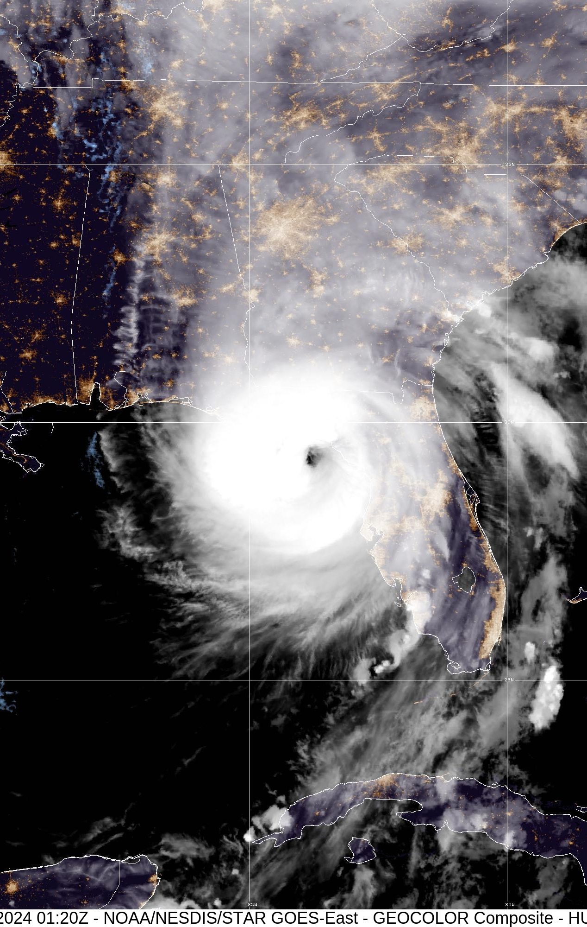
Things to consider prior to submitting
Discuss with local mosquito control programs prior to submitting maps
Be sure to submit all required documents and data
  No treatments will be done without these requirements met
  We will eventually deny your request without them
MCIRT works under ESF 17, not ESF 8
MCIRT has a very short time frame to complete ALL requests and a second request may be denied (about 30 days from landfall)
Product will be an organophosphate
  Resistance to certain mosquito adulticides can impact the required control
Aerial applications is the primary application method
  In most suburban and rural areas, a ground application will not provide the required control
  Workload is increased for ground applications compared to aerial
Notes:
Before submitting a request, there are few things to note.
First, make sure the mosquito control program agrees with the maps before they are submitted. It is possible that the county will not see the maps again until they are concurrent. If there is a dispute or change to the map at that point, MCIRT will have to obtain concurrency once again on the new maps, which will delay the abatement response.
When submitting the request, be sure to include all required items. As stated several times, there will be no treatments planned until all requirements are met.
It is also wise to consider that time is a major factor during activation. Not submitting everything on your own or changing the maps last minute will just prolong the treatment. Also, MCIRT typically has a 30 day window to complete all requests. Post-activation requests will not be accepted.
For the actual applications, the product for the meantime will always be an organophosphate. This is due to increasing resistance to other mosquito adulticides. The chemical will not be changed, even if the county requests it.
Lastly, aerial application will be the primary method of treatment moving forward for future activations.

Slide 11
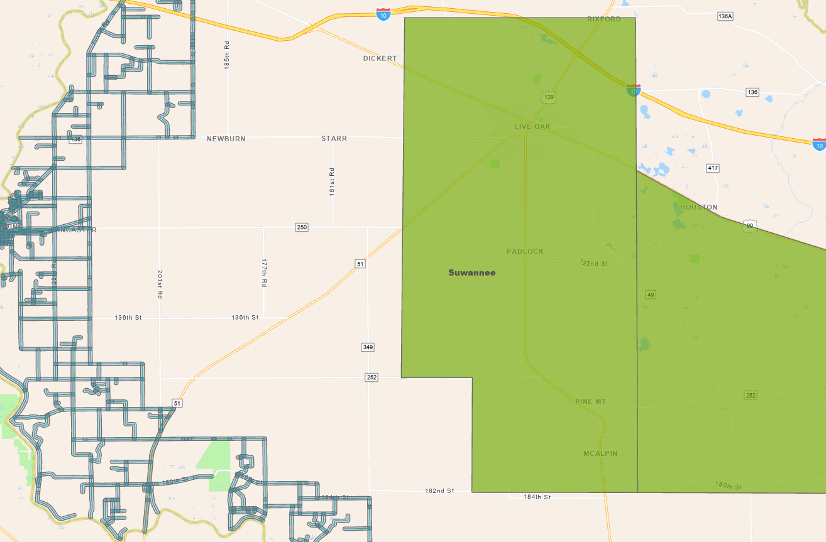
Aerial vs Ground Treatments
Green block is an aerial application treatment
Blue highlighted roads is a ground application treatment
Equivalent overall size, but not treatment size
Notes:
However, in rural and suburban areas, ground applications are slow and minimally effective in suppressing adult mosquito populations. Ground applications using a truck apply up to a 300 foot wide swath from the road. On the left, blue lines represent the entire area treated by a truck on the compared to the green blocks on the right, which represent what planes did in the same time frame. As you can see, there is a significant area left untreated by the ground application. Also important to note, ground treatments require more time and workload for both MCIRT and the contracted applicators. Because of this, the MCIRT will be focused on aerial treatments instead.

Slide 12
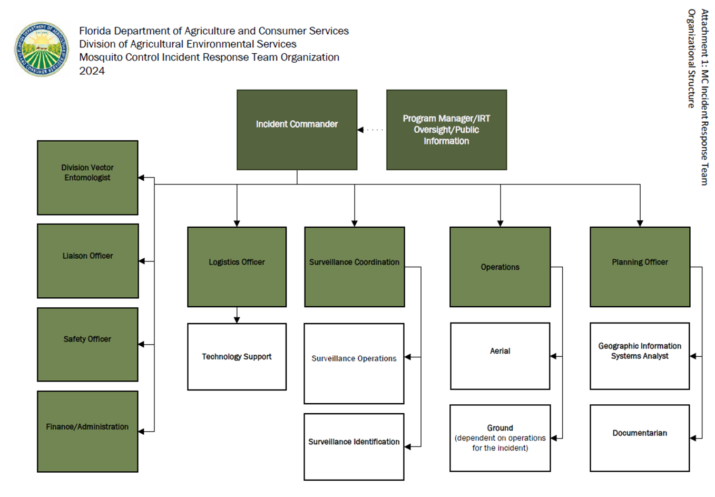
MCIRT
Command Structure
Modified ICS structure
Includes Surveillance Coordination overseen by a vector entomologist
Notes:
The MCIRT is comprised of AES staff and utilizes a modified Incident Command Structure due to the specialized nature of the team. Modified roles include a division vector entomologist who provides expert guidance regarding mosquito behavior during the activation and a surveillance team responsible for all pre- and post-treatment surveillance to determine efficacy.
The command structure also has an operations section divided into two parts: aerial and ground. The past 5 MCIRT activations have only provided aerial treatments. Ground treatments are highly dependent on the severity and location of the aftermath and are only done if an aerial response would not be effective.

Slide 13
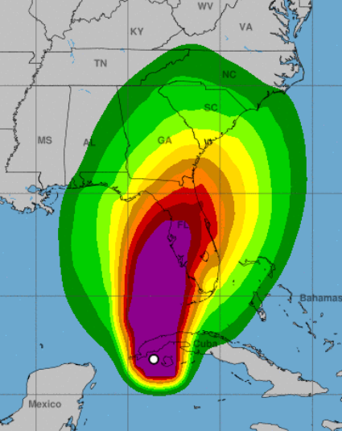
MCIRT Response Process
Prior to Landfall
Incident Commander (IC), Project Management, Division Vector Entomologist (DVE) monitor ongoing situation
As storm approaches, Entomology and Pest Control section (EPCS) staff reach out to mosquito control programs in counties that could be impacted by storm (based on Governor’s declaration)
AES staff assist ESF-17 to monitor WebEOC
Landfall
IC, Project Management, DVE monitor ongoing situation
AES staff continues to assist ESF-17 to monitor WebEOC
Notes:
The entire MCIRT process can be divided into 5 timeframes: prior to landfall, landfall, post-landfall, activation, and response.
Prior to landfall early planning is initiated with the path and severity of the storm heavily monitored. In additional, FDACS AES staff preemptively reach out to the county mosquito control programs most likely to be affected by the storm.
At the point of landfall, AES staff assist ESF 17 to monitor WebEOC for incoming requests.
Following landfall, the MCIRT leadership monitor for the required presidential and governor emergency declaration. Without these, it is very unlikely the MCIRT will activate. Activation will also depend on the storm’s severity and area impacted. Utilizing the impacted counties list provided by FEMA, AES staff once again reach out to the mosquito control programs affected by the storm to determine local mosquito control capacity.

Slide 14
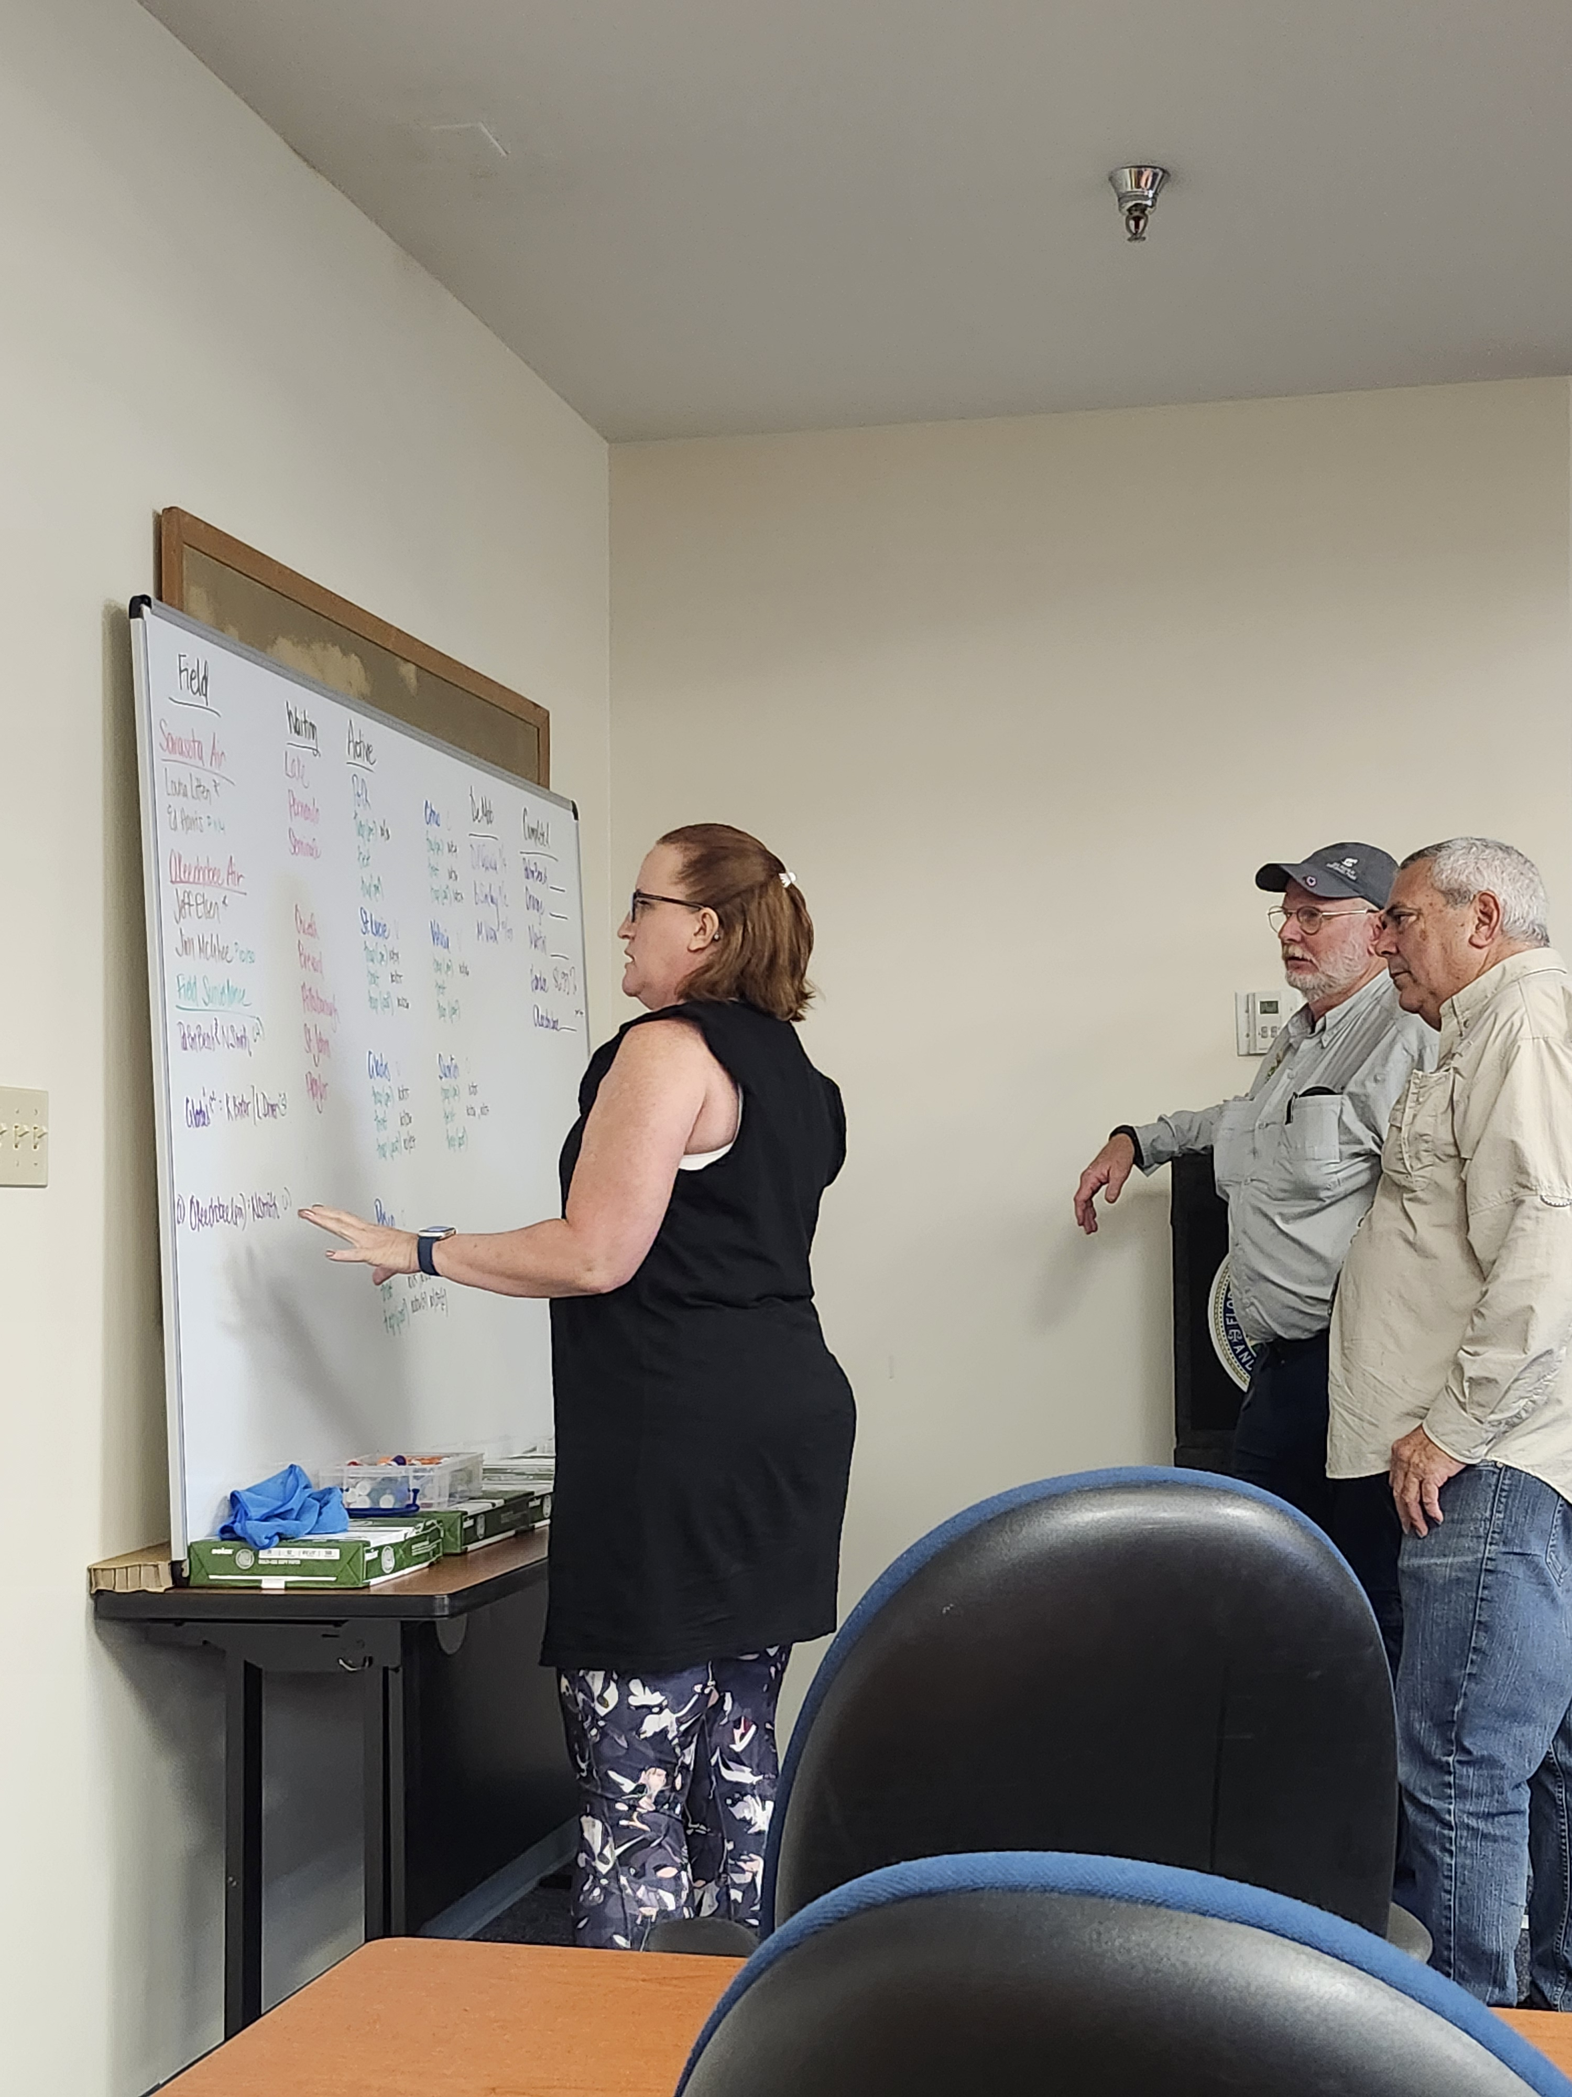
MCIRT Response Process
Post Landfall
IC, Project Management, DVE monitor ongoing situation to determine if MCIRT will be activated
Monitor for Presidential and Governor emergency declaration and FEMA impacted counties list
EPCS staff reach out to mosquito control programs in counties impacted by the storm
Activation
IC, Project Management, DVE monitor ongoing situation
MCIRT Incident Command Post is established and air operations locations determined through communication with contracted services
Staff continue monitoring WebEOC for requests from counties requesting assistance
Planning reviews information submitted by counties requesting assistance to determine if additional information is required
Notes:
The entire MCIRT process can be divided into 5 timeframes: prior to landfall, landfall, post-landfall, activation, and response.
Prior to landfall early planning is initiated with the path and severity of the storm heavily monitored. In additional, FDACS AES staff preemptively reach out to the county mosquito control programs most likely to be affected by the storm.
At the point of landfall, AES staff assist ESF 17 to monitor WebEOC for incoming requests.
Following landfall, the MCIRT leadership monitor for the required presidential and governor emergency declaration. Without these, it is very unlikely the MCIRT will activate. Activation will also depend on the storm’s severity and area impacted. Utilizing the impacted counties list provided by FEMA, AES staff once again reach out to the mosquito control programs affected by the storm to determine local mosquito control capacity.

Slide 15
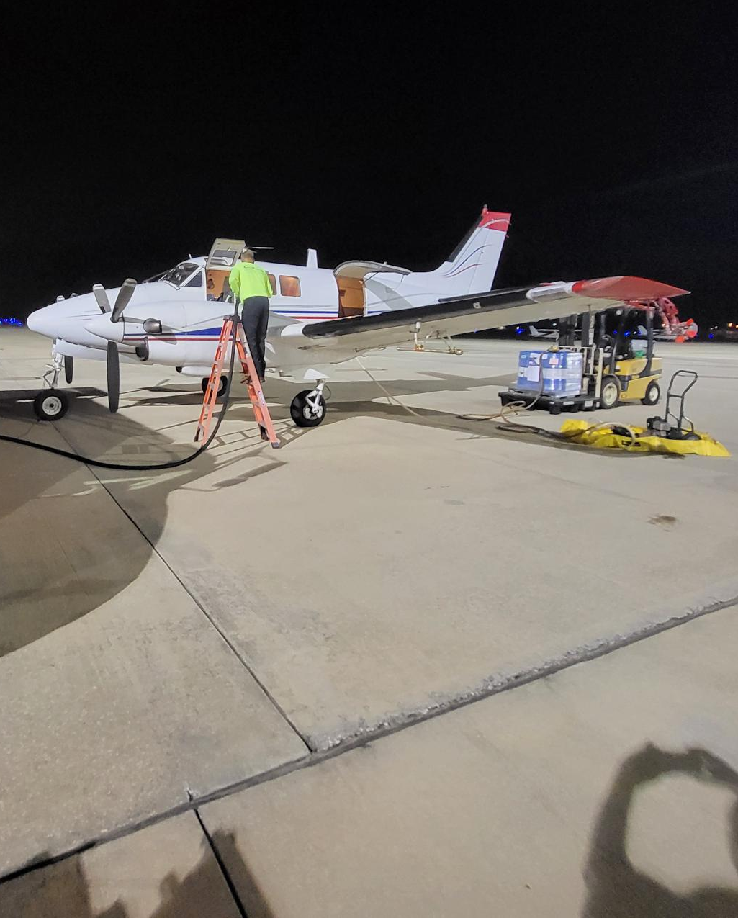
MCIRT Response Process
Response
Field Surveillance starts with setting traps in counties that have requested assistance to verify baseline mosquito populations
GIS maps of treatment areas established with exclusions noted
Concurrency for treatment areas obtained from partnering agencies (USFWS, FWC, FDEP)
Field surveillance collections identified; agreement obtained from CDC
Pre-flight surveillance conducted by vendors
Applications completed between dusk and dawn
After applications are completed, Field Surveillance sets traps for data used to confirm efficacy
Each mission is considered complete if there is at minimum 80% control between pre and post surveillance counts
Continued support with questions and requests for information
Notes:
The entire MCIRT process can be divided into 5 timeframes: prior to landfall, landfall, post-landfall, activation, and response.
Prior to landfall early planning is initiated with the path and severity of the storm heavily monitored. In additional, FDACS AES staff preemptively reach out to the county mosquito control programs most likely to be affected by the storm.
At the point of landfall, AES staff assist ESF 17 to monitor WebEOC for incoming requests.
Following landfall, the MCIRT leadership monitor for the required presidential and governor emergency declaration. Without these, it is very unlikely the MCIRT will activate. Activation will also depend on the storm’s severity and area impacted. Utilizing the impacted counties list provided by FEMA, AES staff once again reach out to the mosquito control programs affected by the storm to determine local mosquito control capacity.

Slide 16
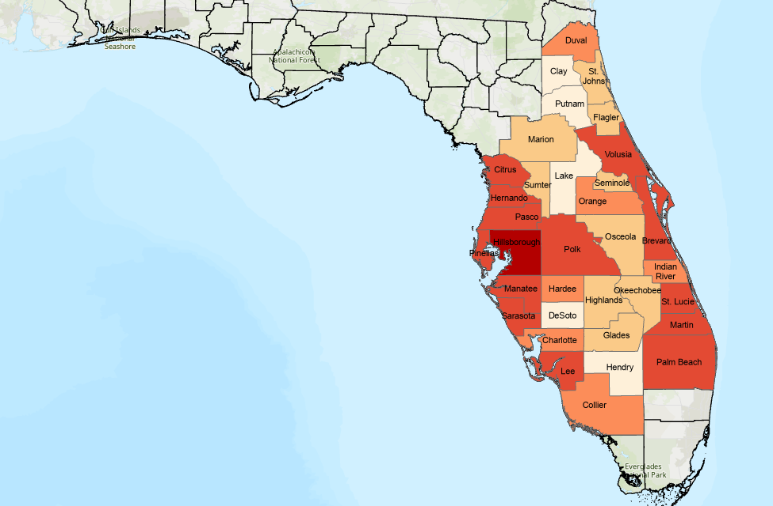
Vulnerability Assessment
Fiscal Constraints
Mosquito Control Response Capacity
Potential Storm Damage
Public Health Risk
Additional factors can be added, if necessary
Replaces County Scorecard used for previous activations
Notes:
The vulnerability assessment is a new tool to provide insight on the counties most in need of assistance. It replaces a scorecard used by the team in past years. This risk assessment examines many variables which change depending on the characteristics of the storm. Some examples are damage, flooding, capacity of mosquito control program, fiscal constraints, and public health risk level.
All variables are combined to create a vulnerability score, portrayed on this map from Milton’s activation. The darker the color, the more vulnerable the county was to increased mosquito populations and mosquito borne disease following the storm.
This tool is initially used to estimate the number of counties which may request assistance and then to determine the response priority for applications. Even if other counties have requested assistance prior, some counties may be sprayed earlier based on these results.

Slide 17
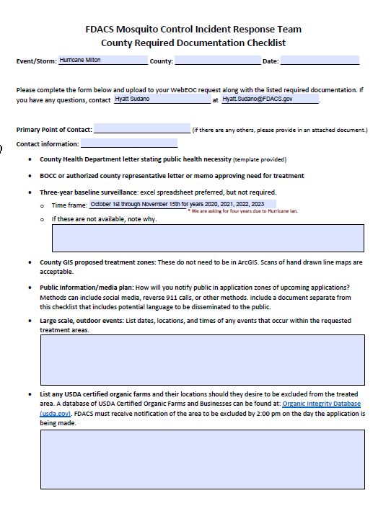
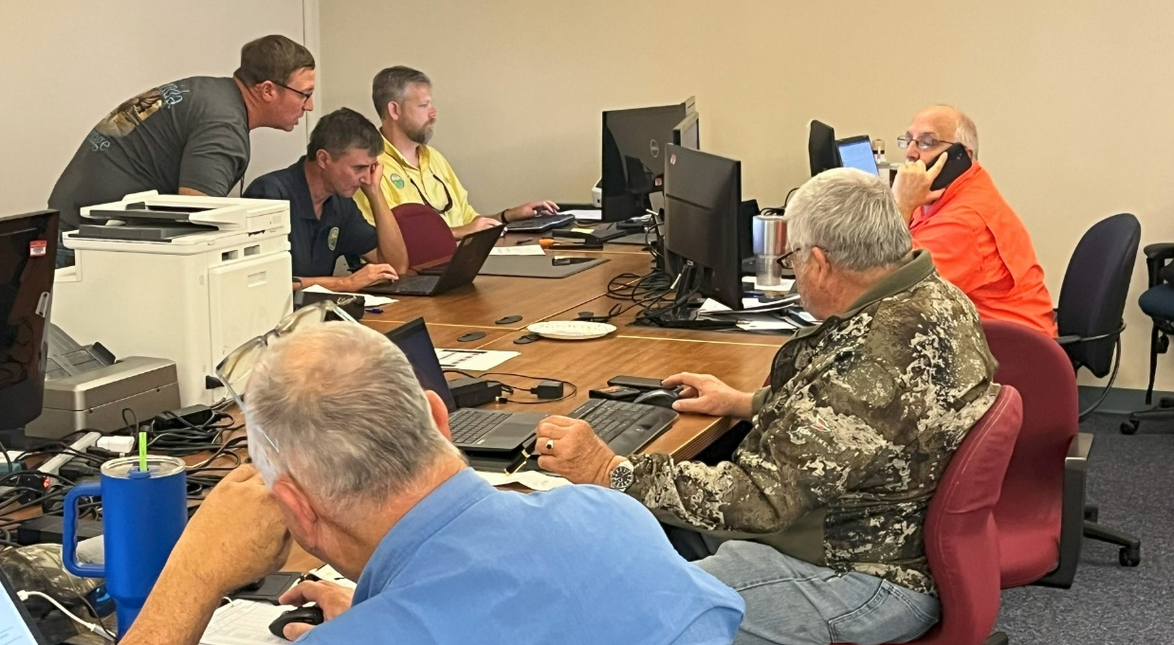
County Required Documentation Checklist
Form sent to counties via WebEOC that outlines required documentation necessary for MCIRT response
Notes:
When a request is first submitted into WebEOC, the planning lead will upload a checklist for the county emergency manager to follow. Please review the document completely. Filling out this checklist will ensure all required information has been submitted and the MCIRT will be able to respond in a timely manner.

Slide 18
County Checklist: Section 1
Storm Event:
  Should be already filled in for the specific event/storm
County:
  Please make sure that the county has been entered
  The information could already be filled in depending on the MCIRT Planning Chief and the volume of WebEOC requests, if not enter County
Date:
  Date the checklist was received by the county

Slide 19
County Checklist: Section 2
Checklist instructions
  Planning Chief contact information can be found in this section, if the information is not pre-populated, please let the MCIRT know as this is a primary point of contact for updates
County point of contact:
  Please enter the name and contact information in case any of the MCIRT leadership need additional information to complete the WebEOC request

Slide 20
County Checklist: Section 3
County Health Department letter
  Request a letter from your county Florida Department of Health
  Template is available on the SART website
  This letter is required for the request to move forward
Board of County Commissioners letter
  Must be obtained from BOCC or appointed representative
  Letter is required for the request to move forward

Slide 21
County Checklist: Section 4
Three-year baseline surveillance data
  Must be obtained from local mosquito control unless there is not a program
  Date range will be provided in this section
  Please only send requested years and months
  Template will be provided to the local mosquito control program, if possible
County GIS proposed treatment zones
  Areas requested for treatment in the county
  Zones should include regions that are both impacted and populated
  Format of maps can range from scanned PDFs/images to GIS files
  Protected areas will be verified and removed by MCIRT

Slide 22
County Checklist: Section 5
Public Information/Media Plan
  An explanation on how the county will notify its citizens of the upcoming treatment
  The selected media outputs for the notice should be broad and not depend on access to social media
  A separate document will be provided through WebEOC for the assigned county Public Information Officer for the event with FAQs and potential public release language

Slide 23
County Checklist: Section 6
Large scale, outdoor events
  Any outdoor events that have been reported to the county that may be ongoing or ending during treatment
  Include all events up to at least 7 days in advance with date, location, and time.
USDA certified, organic farms
  Any organic farms requested to be removed from treatment zones
  Include all, known farm, even if they are not be included in zones
  Farms must be at least 1500 sq ft to insure they are avoided
This information can be updated, but must be provided NLT than noon of the first application day

Slide 24
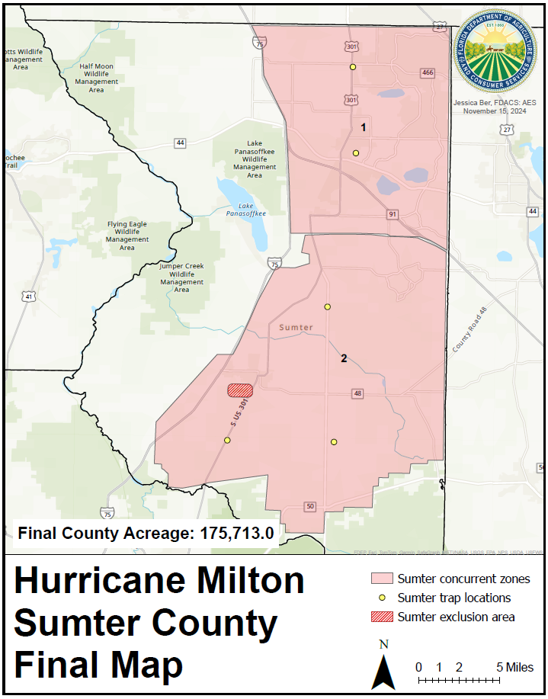
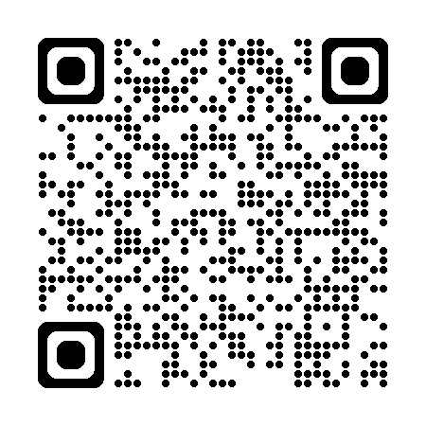
USDA Organic Farm Registry
Notes:
When submitting a request for exclusions, whether for organic farms or outdoor events, there are few things to consider.
First, there are two routes for submitting an exclusion: initially submitted through the WebEOC using the checklist form shown earlier and provided directly to the MCIRT Liaison officer. No matter the method, all exclusions must be submitted no later than noon on the first day of the treatment. This means if the treatment may go for three days, we will require all exclusions for those three days. If there is a retreatment or unforeseen delay, there will be further opportunity to submit exclusions for outdoor events.
Second, the exclusion area must be at minimum 1000 to 1500 square feet. The vendors cannot guarantee smaller areas will be completely avoided. If an exclusion is submitted that is smaller than this requirement, it will be expanded and may exclude areas that were requested for treatment.
Third, exclusions can cause delays in the completion of the treatment. To alleviate this, please submit all required information when the exclusion is originally requested. This includes dates, event start and end times, and address. Please do not add a time buffer. This will all be handled as the MCIRT coordinates the treatments.
Lastly, it is a good idea to already have the exclusion data for organic farms on hand before hurricane season. The QR code here will direct you to the USDA Organic Farm registry where you may look up all registered organic farms in your county.

Slide 25
Requirements of the County Emergency Management
Approval Letters
Determine whom within County FDOH is responsible (template is available on the SART website)
Baseline Data
Three years of relevant CDC light trap baseline data from non-event years
Maps
Review current or create new maps illustrating of the potential areas affected
Press Release Plan
It is the county’s responsibility to develop and implement the release of information regarding applications
Assists in verifying the increase in mosquito populations post-storm
A template will be provided with the necessary time frame
Requested zones should focus on critical response areas
County Flood Zone maps may be a useful tool
Suggested release language provided with checklist
Board of County Commissioners letter of support
Should have as much coverage as possible (i.e., press release, reverse 911 calls)
Notes:
As a part of FEMA requirements, each request will need specific information prior to the MCIRT responding to a WebEOC request. If information is missing, an MCIRT representative will request that it be provided prior to the team beginning a response.
Counties must include two letters, one from the county FDOH documenting the increased potential for mosquito borne disease and one from the Board of County Commissioners to support wide area applications. It is up to Emergency Management to know who within the county to request these letters from. You may find a letter template on the SART website.
The second requirement is CDC Light Trap baseline data. This information will need to come from the mosquito control program. A template Excel file will be sent to the county mosquito control program when a WebEOC request is submitted by the emergency management. Per FEMA requirements, counties need to submit 3 consecutive, non-incident years. If a county cannot submit baseline data, then measures may be taken to supplement with the pre-treatment trap data or other criteria. Please note that providing baseline data is in the best interest of the county, as it is used by the CDC to determine approval for the response.
Another requirement that involves the local mosquito control program is the submission of proposed spray maps. These will show the areas that the county is requesting to be sprayed. It is important to carefully select the areas based on population and hurricane impact. Shapefiles or created maps are preferred, however not everyone has those tools available to them. If the only map that can be sent is a basic scanned county map with hand drawn spray zones, the MCIRT GIS specialist will work with the county to create representative spray zones. Also, this team member may reach out to obtain additional information if issues are found. Make sure to include ALL possible areas to be treated in the request process. If the county decides to have additional areas added after concurrency has been obtained, it can delay the process. Also, it can be very difficult to revisit a county once applications are completed and the request is closed in WebEOC.
Finally, it is important that the county submit a Public Information or Press Release Plan. This will explain how county officials plan to notify their citizens of any upcoming spray events. This can be often overlooked but is necessary before an planes go into the air. Suggested language found on the checklist may be utilized when drafting the plan.

Slide 26
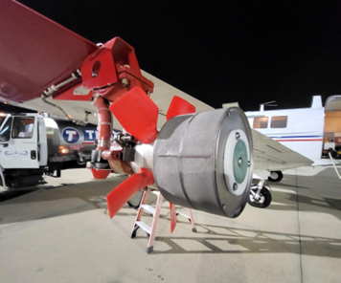
Obstacles to completing a WebEOC Request for assistance
Weather
Rain delays
Temperature below pesticide label rate
Wind speed at time of applications
Mechanical
Dedicated planes
Plane malfunction
Fuel issues
Equipment issues
Pesticide availability
Personnel
Incomplete licensure
Pilot rest
Incomplete County Requests
GIS shape files
BOCC or FDOH support letters
Mosquito Surveillance Baseline for the requested timeframe
County Public Information Release plan
Organic Farms or large scale outdoor public events
Concurrency
GIS map exclusions
CDC agreement
FDEP concurrency
FFWCC concurrency
USFWS concurrency
FDACS Forestry concurrency
Limited number of vendors
Notes:
In a perfect scenario, the entire process of response would only take 5 days per county. There are many obstacles that prolong the process and extend the time required for assistance.
Weather is a common obstacle for mosquito treatment. First, pilots cannot fly during rain and must post-pone flights in the event a storm. Additionally, there temperature and wind speed specifications as per label which prohibits treatment during certain conditions.
There is always the possibility of mechanical malfunctions of the vendor’s equipment prior to or during the treatment. This can include plane malfunctions, fuel issues, or the unavailability of pesticide.
There can also be issues pertaining to the vendor personnel. This includes lack of or incomplete licensure to be able to treat mosquitoes in Florida. Also, longer activations will require pilot rests which may delay treatments. This is especially true consider there are only two vendors that may be contracted for large-scale mosquito treatment in Florida.
Major delays at the beginning of the county response are often due to incomplete WebEOC requests. The MCIRT cannot proceed until it has been provided the requested spray zone map, the BOCC and FDOH support letter, and a public information release plan. Baseline surveillance should be provided if available. Lastly, the county should provide exclusions at the time of submission but will have opportunity to requested one closer to the treatment.
Another obstacle that occurs early in the response is a complication with obtaining concurrency. All treated areas must be approved by these entities before any treatments can be done. Further, if a county provides an updated map with a new area covered, concurrency will have to be obtained again, delaying the treatment. These concurrency stakeholders can also cause delays directly due to slow communication, particularly over the weekend.

Slide 27
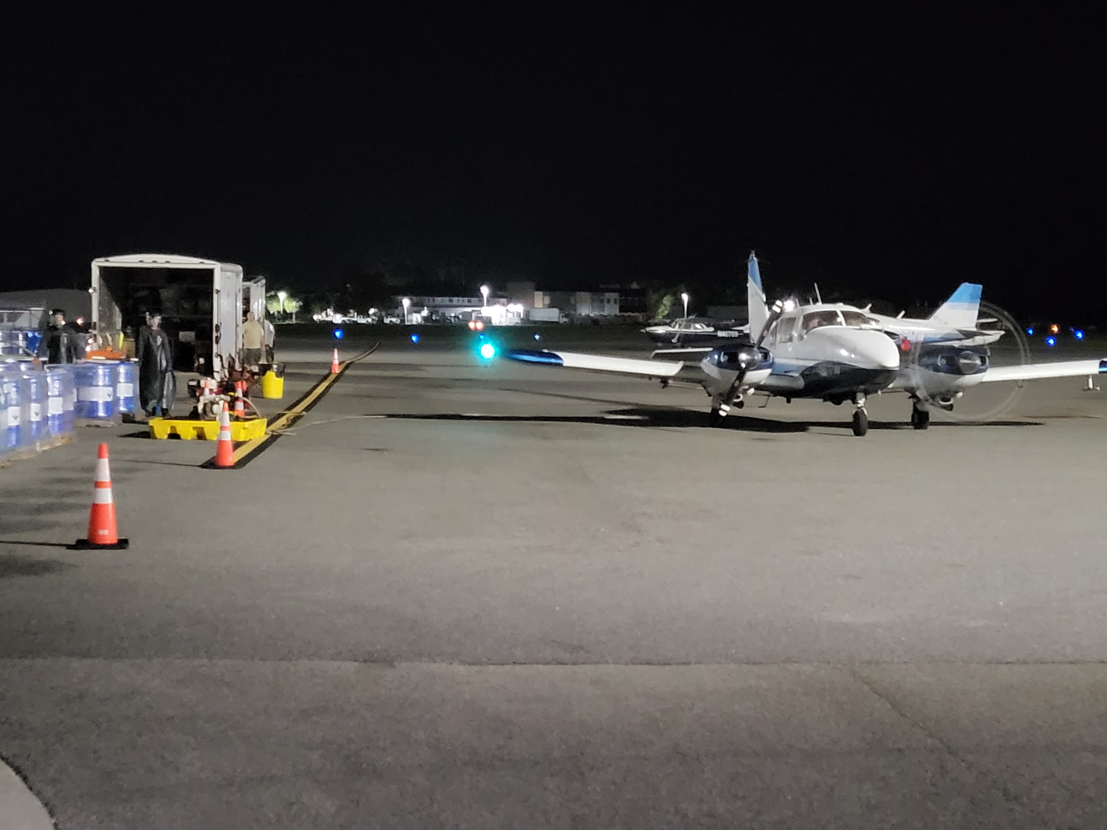
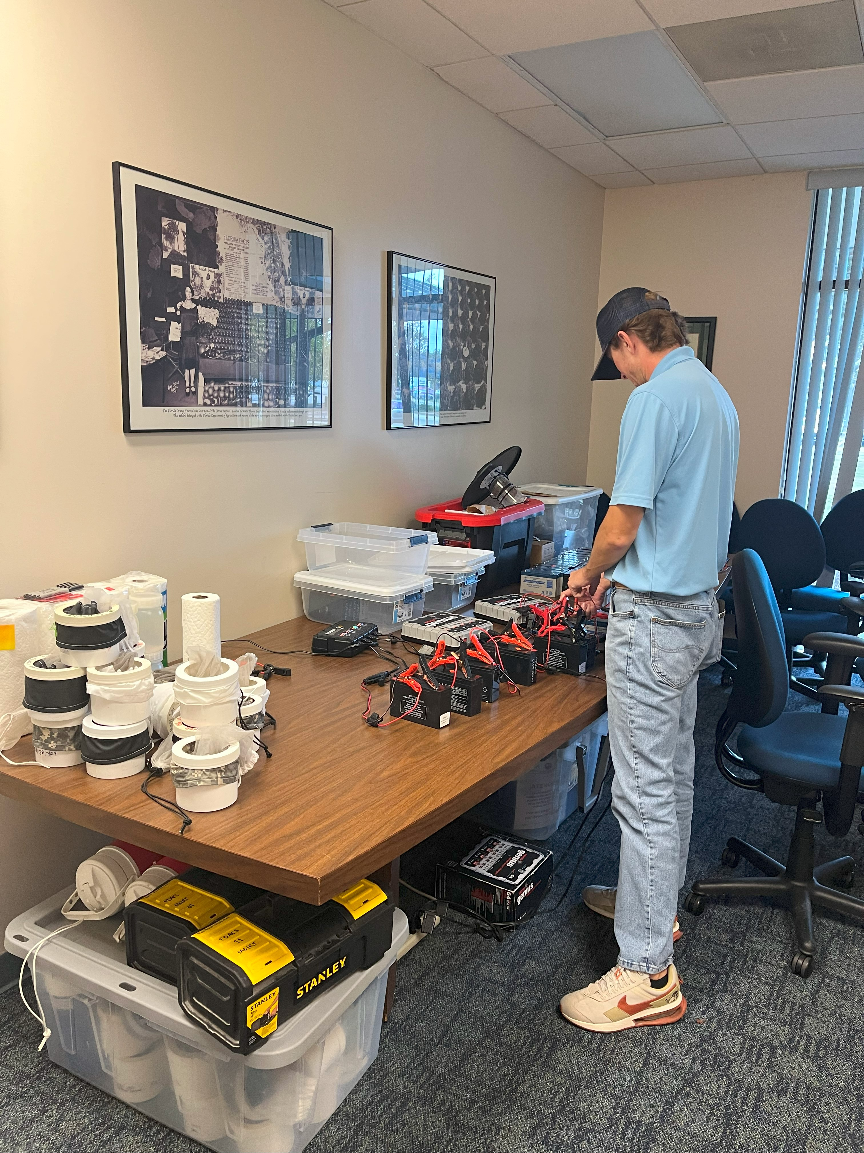
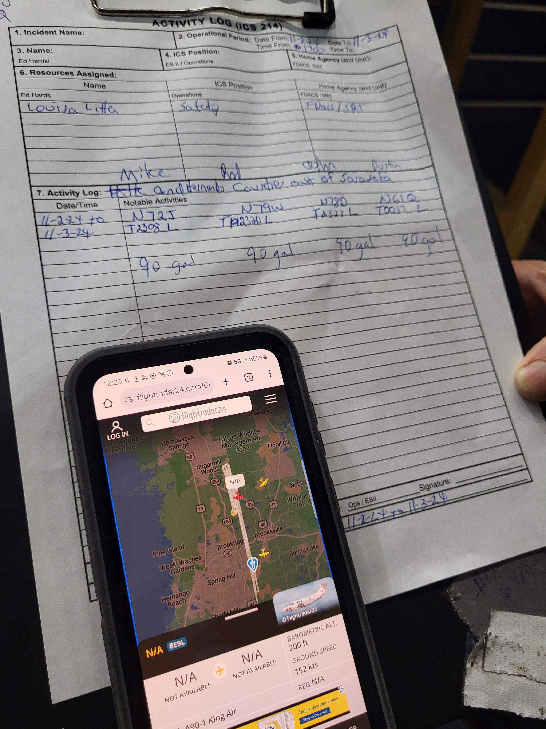
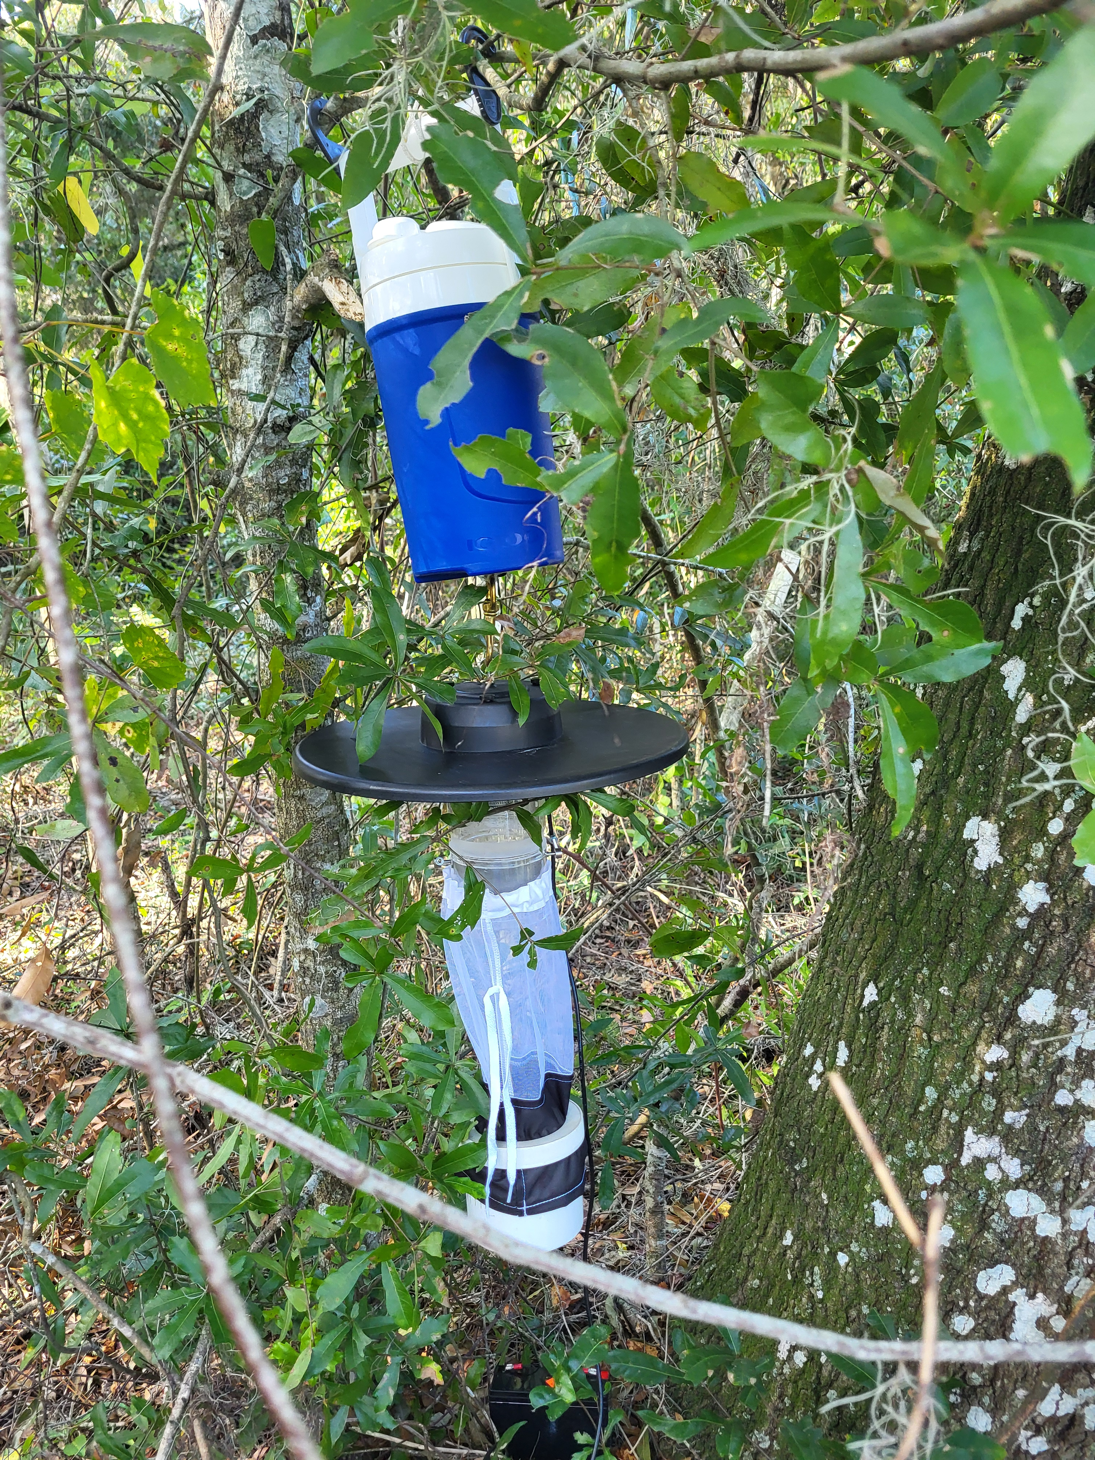
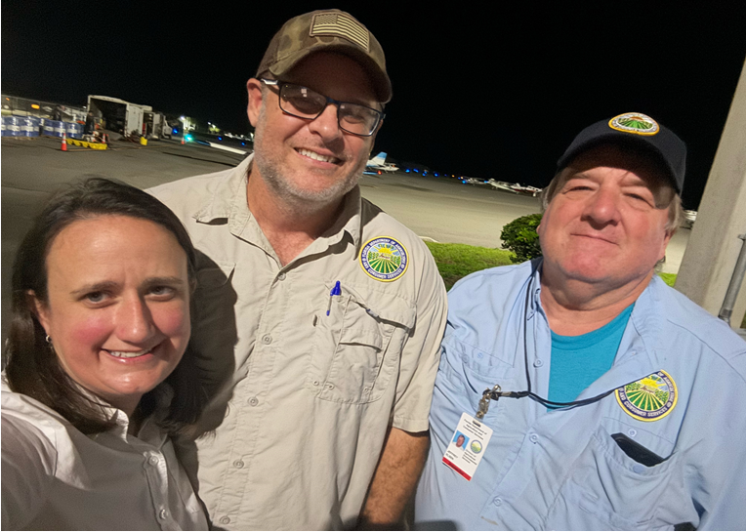
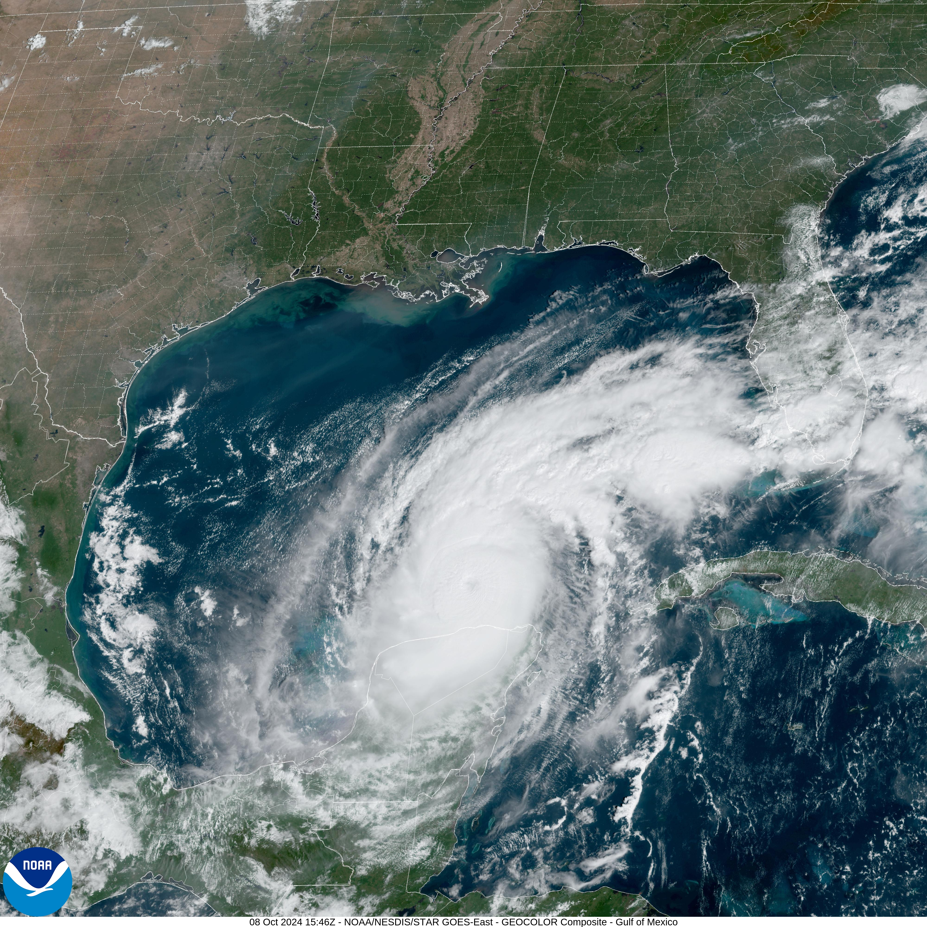
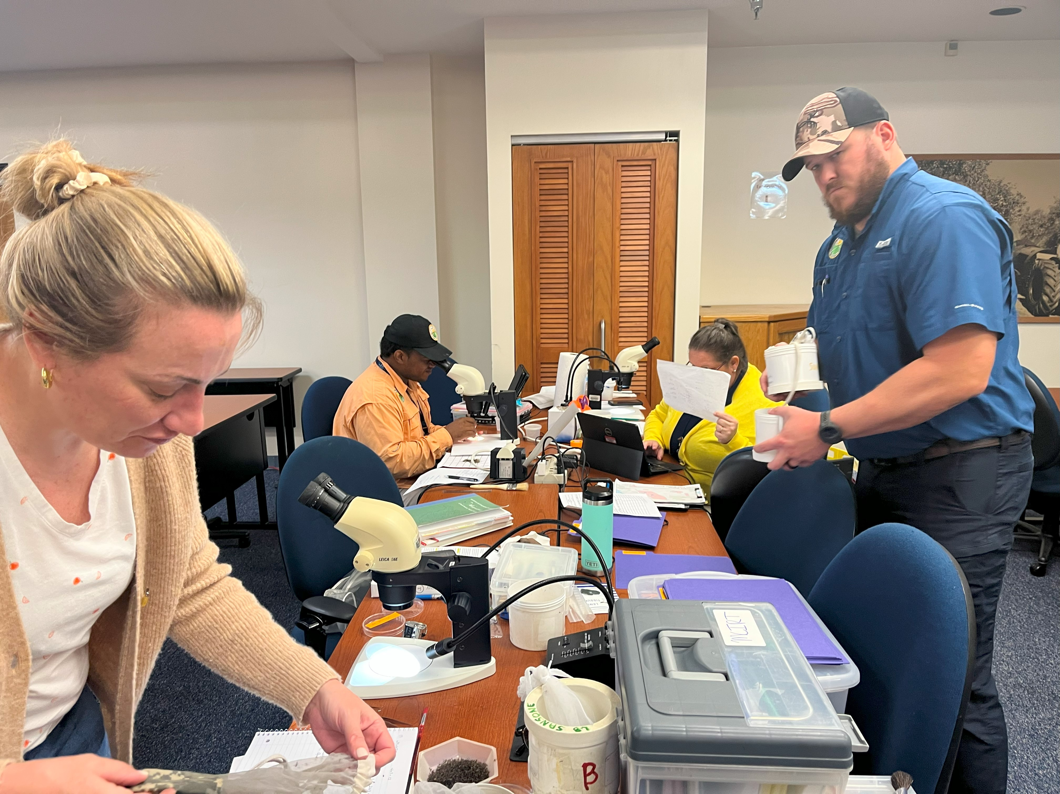
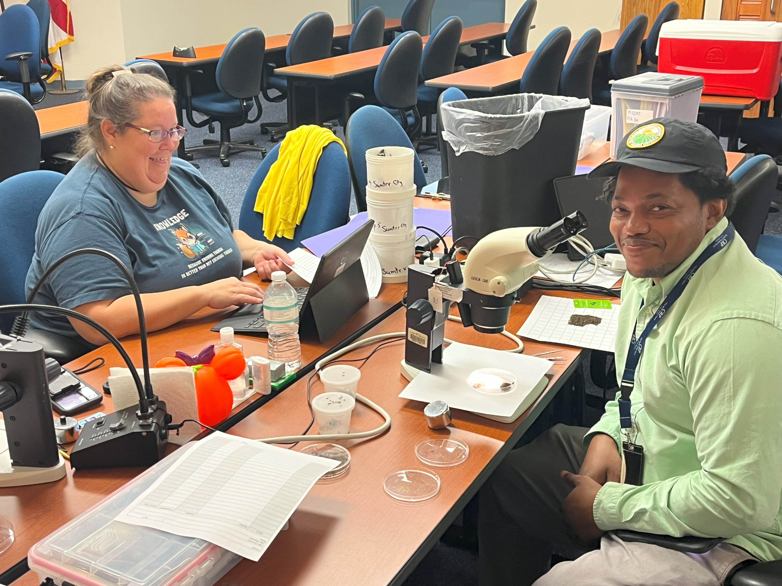
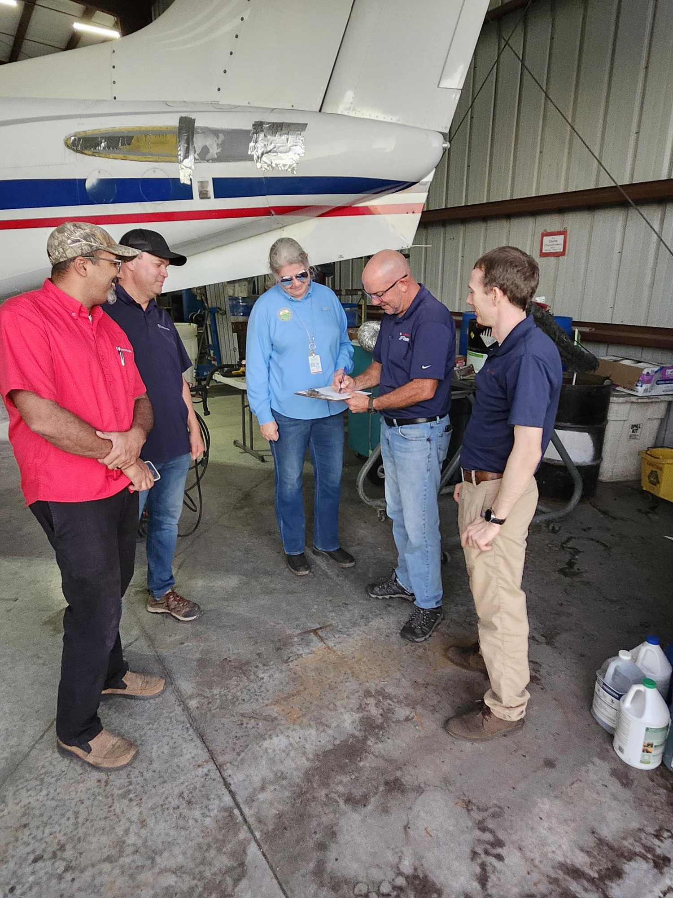
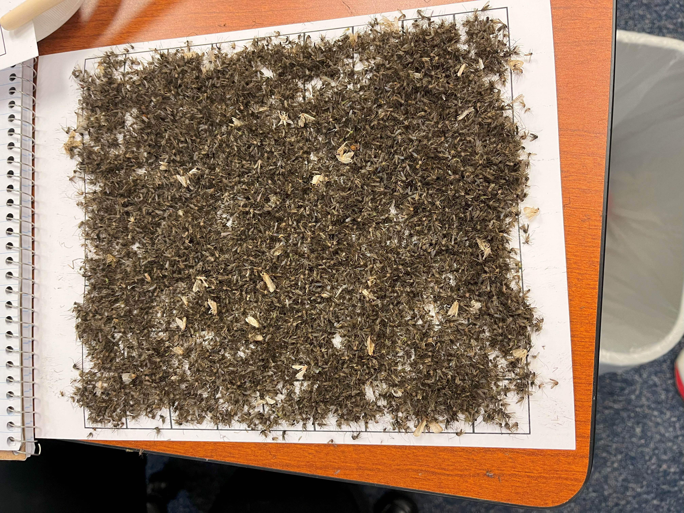

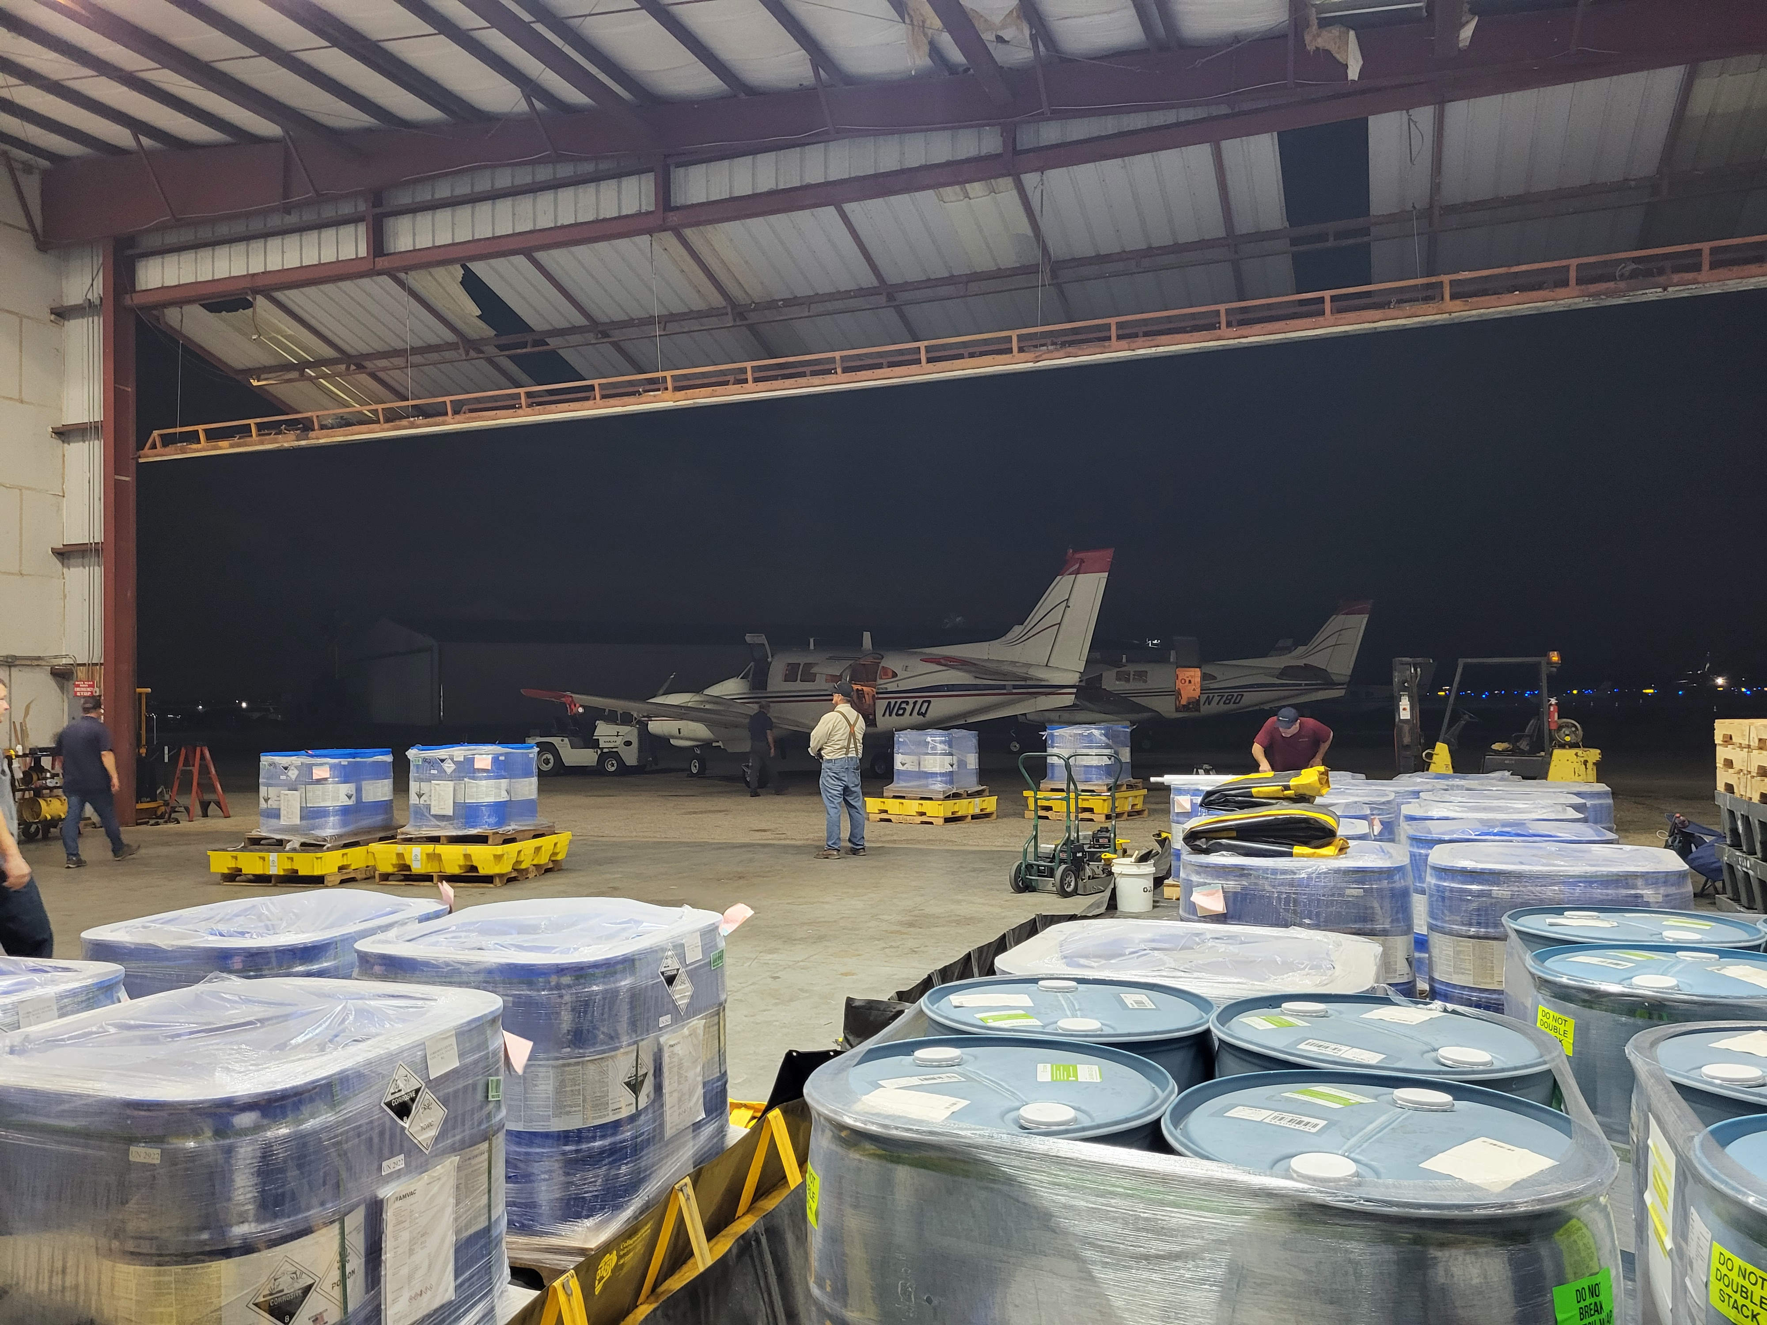
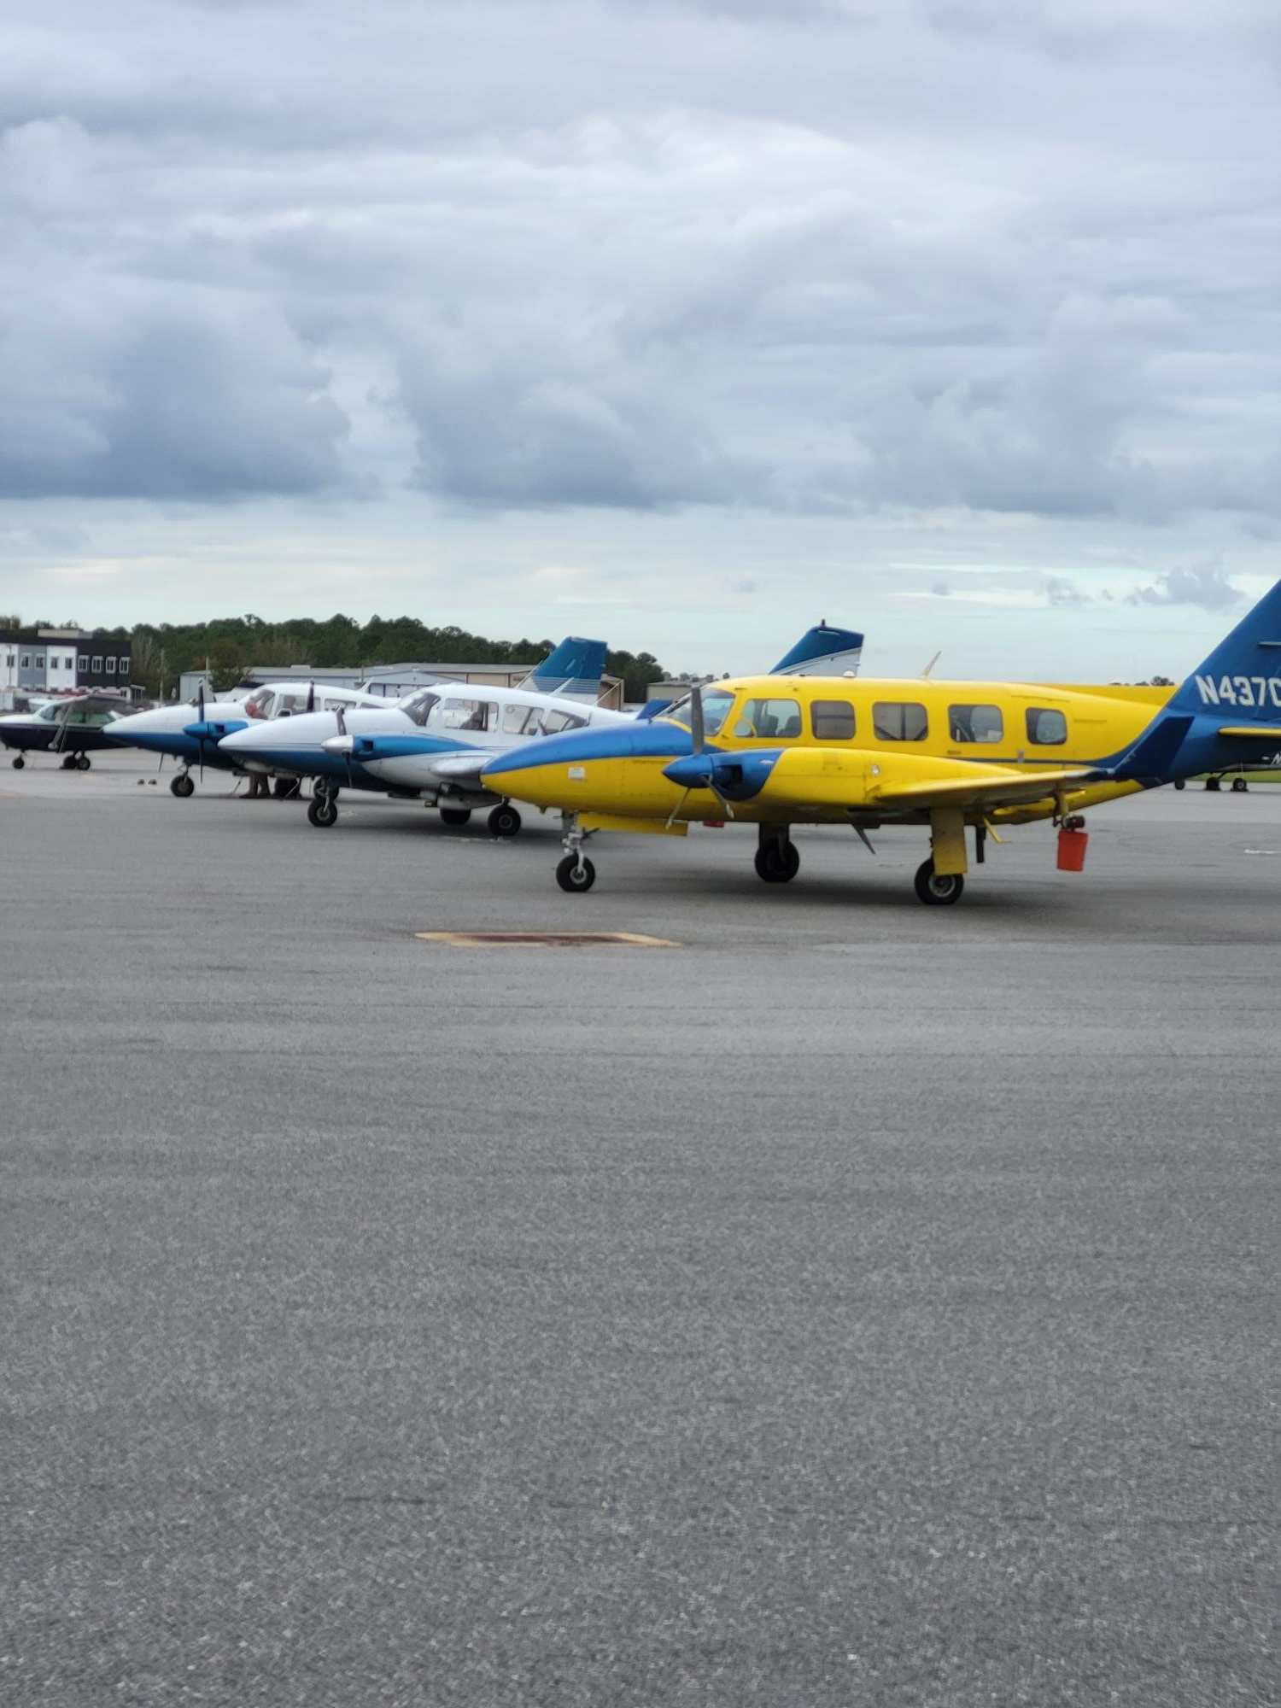
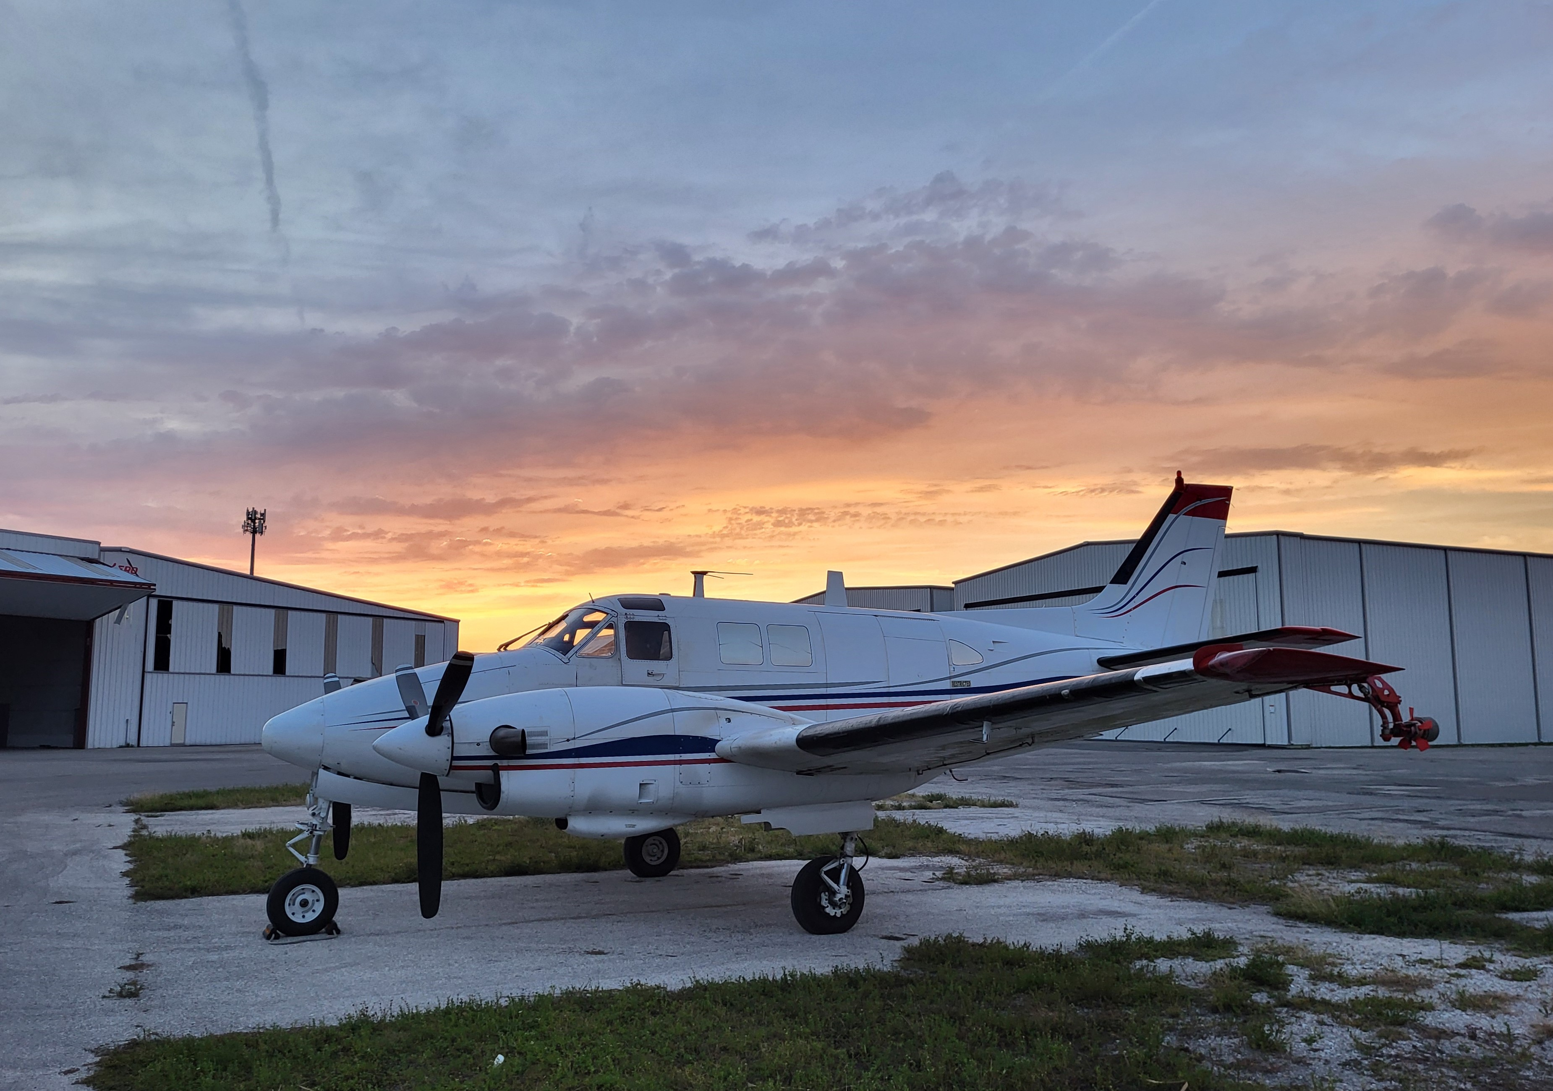
Notes:
Here are some images showing the work done by the MCIRT in 2024. Between the three activations, the team was activated a total of 48 days and required the work of 33 FDACS AES employees.

Slide 28

Questions?
Marah Clark
Environmental Administrator
Marah.Clark@FDACS.gov

